Slide 1
Biostatistical Support at WMed
November 15, 2023
Jeff Young
Biostatistician
Department of Biomedical Informatics
Western Michigan University Homer Stryker M.D. School of Medicine

Slide 2
Biostatistical Support at WMed
PRESENTATION OVERVIEW --
REVIEW OF THE DEPARTMENT OF BIOMEDICAL INFORMATICS AT WMED
THREE BASIC STATISTICAL CONCEPTS
Sample Size and Statistical Significance
P Values
Confidence Intervals
ROLE OF A BIOSTATISTICIAN AT WMED

Slide 3
Biostatistical Support at WMed
First and Foremost -- The Department of Biomedical Informatics Provides a Service to the WMed Community
Research Support Teams at WMed --
Data Analytics Services Unit -- including the WMed Virtual Data Warehouse (VDW)
Human Research Protection Program (HRPP)
Biostatistical Assistance

Slide 4
Biostatistical Support at WMed
Research Support Teams at WMed Assist with Various Elements of Study Endeavors
Protocol Development
IRB Compliance
Clarifying Research Aims & Objectives
Statistical Analyses -- including sample size and power calculations
Data Collection
Cleaning, Formatting, and Organizing Data
Tabular and Graphical Summaries
Statistical Wording for Manuscripts and Grant Proposals

Slide 5
Biostatistical Support at WMed
Additional Support at WMed
General statistical questions
Journal articles -- selection and interpretation
Grant proposals
Clarifying common statistical misperceptions

Slide 6
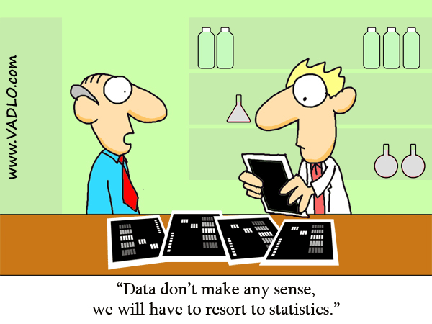
Biostatistical Support at WMed
One well-known saying that should be retired immediately is…
“The Data Speaks for Itself”
“These data don’t make sense… we’ll have to resort to statistics”

Slide 7
Biostatistical Support at WMed
In actuality, data should
never be allowed to speak without a good interpreter !

Slide 8
Sample Size and Statistical Significance
Sample size P-value Significance
EXAMPLE: Human body temperatures are normally distributed with a mean of 98.6° F and a standard deviation of 0.72° F
Sample Size | x̄ | µ | s
5,000 | 98.8 | 98.6 | 0.68363
16 | 98.8 | 98.6 | 0.68363
25 | 98.8 | 98.6 | 0.68363
64 | 98.8 | 98.6 | 0.68363
100 | 98.8 | 98.6 | 0.68363
256 | 98.8 | 98.6 | 0.68363
µ = 98.6
σ = 0.72
x̄ = 98.8 s = 0.68363
n = 5,000

Slide 9
Sample size and Statistical Significance
H₀: µ = 98.6 vs. H_{a}: µ ≠ 98.6
t-tests with different sample sizes
assuming -- x̄ = 98.8 s = 0.68363 µ = 98.6 σ = 0.72
SAMPLE SIZE | Test statistic (t) | P-value
16 | 1.17 | 0.260
25 | 1.46 | 0.157
64 | 2.35 | 0.022
100 | 2.94 | 0.004
256 | 4.65 | 0.0000053

Slide 10
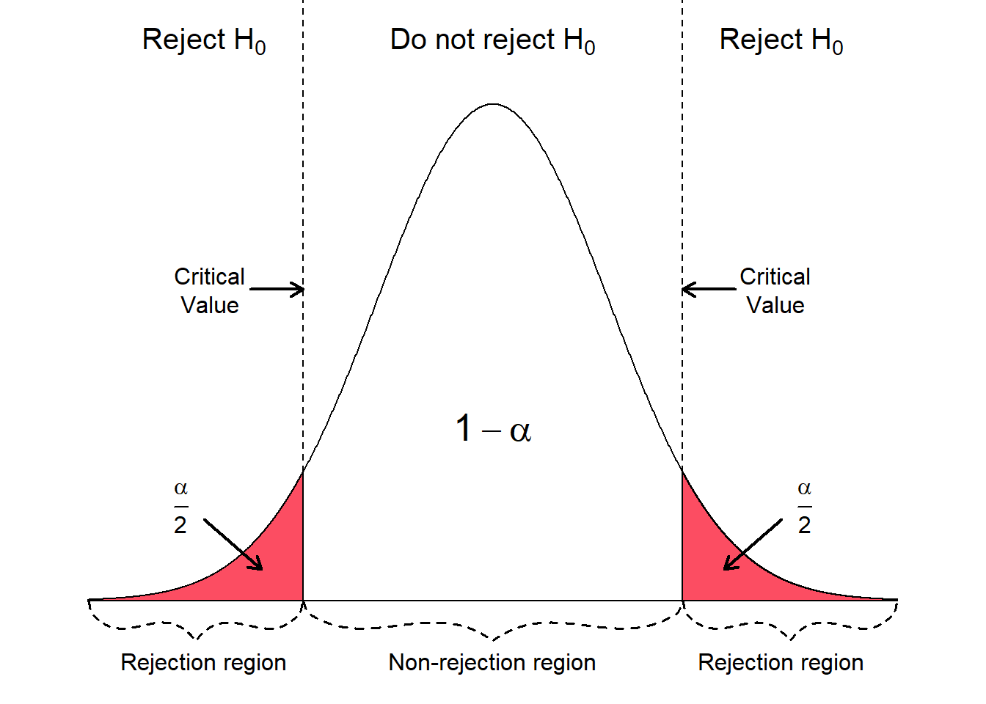
Sample size and statistical significance
t-test results
x = 98.8
µ = 98.6
s = 0.68363
n = 16, 25, 100, 256
Statistically significant
Statistically significant
| | | | |
Test statistic (t) 0 1.17 1.46 2.94 4.65
sample sizexxxxxxxxxxxxxxxxxxxxxxxxxxxxxx n=16 n=25 n=100 n=256xxxxxx
p-value xxxxxxxxxxxxxx xxxx xxxxxxxxx .260 .157 .022 x .0000053xx x

Slide 11
Understanding Probability Values (p-values)
The “formal definition” is expressed via mathematical terminology…
In statistical hypothesis testing, the p-value or probability value or asymptotic significance is the probability for a given statistical model that, when the null hypothesis is true, the statistical summary (such as the sample mean difference between two compared groups) would be the same as or of greater magnitude than the actual observed results
It is a statistical measurement used to validate a hypothesis against observed data
The probability value domain is -- [ 0 ≤ p-value ≤ 1 ]

Slide 12
Breaking down p-values for a non-statistical audience…
It is a statistical measurement (often calculated from a statistical test)
It is a probability expressed as a number
range from 0 to 1 (inclusive) occasionally 0% to 100% (inclusive)
It is conditional
an event occurrence, given that another event (by assumption, presumption, assertion, or evidence) is already known to have occurred
In our context -- Given that the Null Hypothesis is True
Null hypothesis (nothing is happening)
Hypothesis of no change -- Conventional wisdom -- Status quo
Alternative hypothesis (something is happening)
Research hypothesis -- Experimental hypothesis -- Directional hypothesis

Slide 13
Informally P values can be thought of in terms of
Evidence Against the Null Hypothesis
Strength of how well the sample data support the argument that the null hypothesis is true
Measures how compatible your data are with the null hypothesis
How likely is the effect observed in your sample data if the null hypothesis is true?

Slide 14
Understanding P values
Evidence Against the Null Hypothesis
P = 0.216 supports the argument that the null hypothesis is true to a greater extent then a sample p-value of 0.014… so, the smaller p-value shows greater evidence against the null
P = 0.862 reveals a greater degree of compatibility between your data and the null hypothesis, compared to a p-value 0.024
P = 0.384 shows a more likely effect observed in your sample data if the null hypothesis is true vs. a p-value of 0.042

Slide 15
Understanding Confidence intervals
Anatomy of a 95% Confidence Interval
Confidence Interval: POINT ESTIMATE ± MARGIN OF ERROR
Sample info: POINT ESTIMATE = 3.37 ● z multiplier (95% confidence) = 1.96 ● standard error = 0.75
MARGIN OF ERROR: z multiplier * standard error
MARGIN OF ERROR ➔ 1.96 * 0.75 = 1.47
3.37 ± 1.47 ➔ 3.37 – 1.47 = 1.90 and 3.37 + 1.47 = 4.84
95% CI (1.90, 4.84)

Slide 16
Interpreting confidence intervals
EXAMPLE 1: Political polling… Which Candidate Is Leading?
A poll (sample) of 400 likely voters yields the following:
CANDIDATE A 54% CANDIDATE B 46% (these are point estimates)
The poll has a margin of error (MOE) of ± 5%
This means…
The “true” percentage for CANDIDATE A is between 49% and 59%
The “true” percentage for CANDIDATE B is between 41% and 51%

Slide 17
Interpreting confidence intervals
EXAMPLE 1 (continued) : Political polling… Which Candidate Is Leading?
Graphically we have:
CANDIDATE A vs. CANDIDATE B
<-----------------------------(----------|----------)--------------------------->
49 54 59
<------------(----------|----------)-------------------------------------------->
41 46 51
Since the confidence intervals overlap, we cannot claim there is a statistically significant difference (at a 95% confidence level) in the true percentage of voters supporting CANDIDATE A and the true percentage of voters supporting CANDIDATE B
In other words, we conclude that there is not statistical evidence, at the 95% confidence level, that voters support CANDIDATE A over CANDIDATE B xx

Slide 18
Interpreting confidence intervals
EXAMPLE 2: Political polling… Which Candidate Is Leading?
A poll (sample) of 1,000 likely voters yields the following:
CANDIDATE A 54% CANDIDATE B 46% (these are point estimates)
The poll has a margin of error (MOE) of ± 3%
This means…
The “true” percentage for CANDIDATE A is between 51% and 57%
The “true” percentage for CANDIDATE B is between 43% and 49%

Slide 19
Interpreting confidence intervals
EXAMPLE 2 (continued) : Political polling… Which Candidate Is Leading?
Graphically we have:
CANDIDATE A vs. CANDIDATE B
<-------------------------------------------(-------|-------)------------------------>
51 54 57
<----------------------(-------|-------)--------------------------------------------->
43 46 49
Since the confidence intervals do not overlap, we can claim there is a statistically significant difference (at a 95% confidence level) between the true percentage of voters supporting CANDIDATE A and the true percentage of voters supporting CANDIDATE B
In other words, we conclude that there is statistical evidence, at the 95% confidence level, that likely voters support CANDIDATE A over CANDIDATE B

Slide 20
Confidence Intervals and Probability
A common misperception is that a confidence interval is “directly” associated with the probability of the variable being measured. For example, consider the statement --- “There is 95% confidence that the true proportion of voters who favor candidate A is between 42% and 48%.” The 95% interval is NOT a range of probabilities for the proportion of voters who favor candidate A; rather, the 95% is associated with the confidence in the success rate of the procedure/process used to generate the interval.
Consequently, it is not correct to say that there is a 95% probability that the true percentage favoring candidate A is between 42% and 48%. Similarly, it is not true that the interval has 95% probability to include the population parameter.

Slide 21
Confidence Intervals and Probability
In actuality, the probability that the true proportion (i.e. the population parameter) falls within the confidence interval is either 0 or 1. In other words, a sample is used to generate an interval that either contains the population parameter (i.e. the true proportion) or it does not contain the population parameter; there is no way of being certain, short of sampling everyone. In other words, we cannot know the true population parameter without conducting a census.
If we were to select many different samples (of the same size) and construct the corresponding confidence intervals, 95% of them would contain the value of the population proportion and 5% of the time the true population proportion will lie outside the interval. This is a subtle, but important, difference from claiming that there is a 95% probability that the true parameter lies between the two values in the interval.

Slide 22
Biostatistical Support at WMed

Slide 23
Biostatistical Support at WMed
We speak different languages
Medical jargon vs. Statistical-ese
Biostatisticians serve as a bridge between the various Medical Domains and the Realm of Biostatistics

Slide 24
Biostatistical Support at WMed
To Reiterate -- The Department of Biomedical Informatics Provides a Service to the WMed Community
We are a work in progress -- we are striving to improve our services and underlying organization to facilitate the research experience at WMed.
xxWe are here to support you !xx

Slide 25
Biostatistical Support at WMed
Thank you for Listening !
Questions ?
Comments ?

